Slide 1
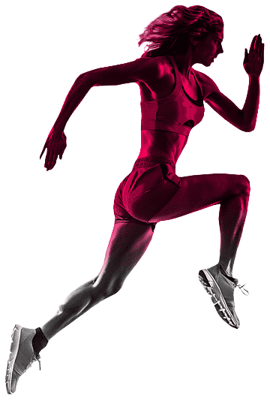

CoachFit
An AI-driven personal trainer
in the palm of your hands
TEAM SUPERLUMINAL
Notes:
x

Slide 2
The Concept
We provide users with an AI-driven alternative to
traditional gym coaches & trainers, making fitness
accessible & inexpensive to the young population.
Notes:
provide users - AI driven alternative to traditional fitness trainers - makes fitness accessible & inexpensive -

Slide 3
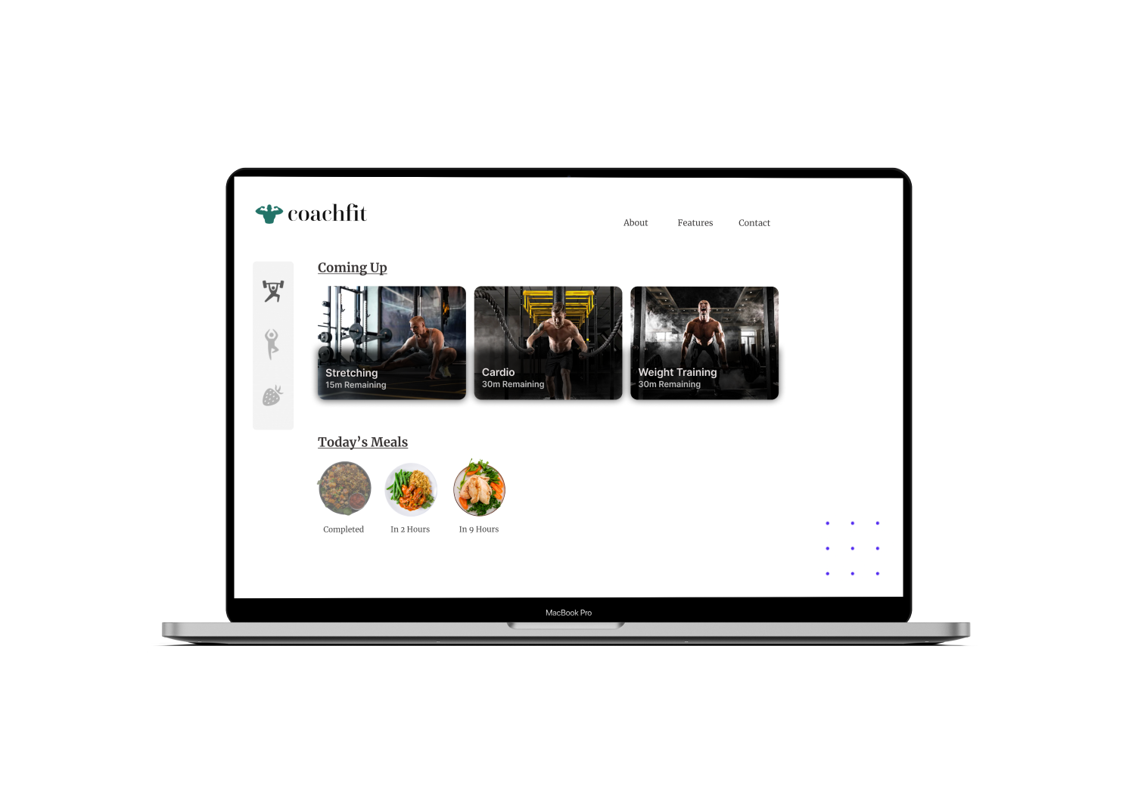

Slide 4
The Problem
Outrageous costs, lack of flexibility, & more

Slide 5
CPS Analysis
₹2000
₹1800
Data sourced from
adityabirlacapital.com & superprof.co.in
₹1600
₹1400
₹1200
Surveys conducted in
2020 & 2021 respectively
₹1000
₹800
₹600
₹400
₹200
Tier 1
Tier 2

Slide 6
Our Solution
Ridiculous pricing, extreme flexibility, & more

Slide 7
CPS Analysis
₹2000
₹1800
Data sourced from
adityabirlacapital.com & superprof.co.in
₹1600
₹1400
₹1200
Surveys conducted in
2020 & 2021 respectively
₹1000
₹800
₹600
₹400
₹200
Tier 1
Tier 2

Slide 8
VALUE PROPOSITION
Budget Friendly
Flexibile
Personalized
A heathy lifestyle w/o breaking the bank.
Work out anytime, anywhere, conveniently.
Exercises curated for your fitness goals.

Slide 9
Our Tech Stack
Front-End, Back-End, & Everything in Between

Slide 10
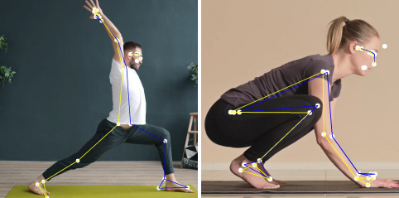
PoseNet by ML5.js
Image Source - https://arxiv.org

Slide 11

PoseNet by ML5.js
Image Source - https://arxiv.org

Slide 12
The Tech Stack
Vue 3
Runs the frontend
Vanilla JavaScript
Runs the backend
Capacitor.js
Runs the native app
Pinia, Axios, & More
Runs everything else

Slide 13
The Business Aspect
Addressable market, Aqcuisition, & More

Slide 14
The Business Pitch
Feasibility, Pricing, Customer Acquisition, & More
01.
02.
03.
04.
-10x Pricing
No Loss Acquisition
Unbeatable Value
Large Audience
Budget friendly subscriptions
with upto -10x pricing
AI-driven means costless
customer acquisition
Bundled with Meal Prep,
Curated Workouts, & more
Both Tier 2 & Tier 3 regions
are targettable

Slide 15
Thank You !

